Slide 1

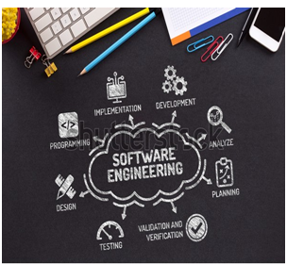

BCAC0010: System Design & Software Engineering
Class Presentations on Introduction to System Design & Software Engineering

Slide 2
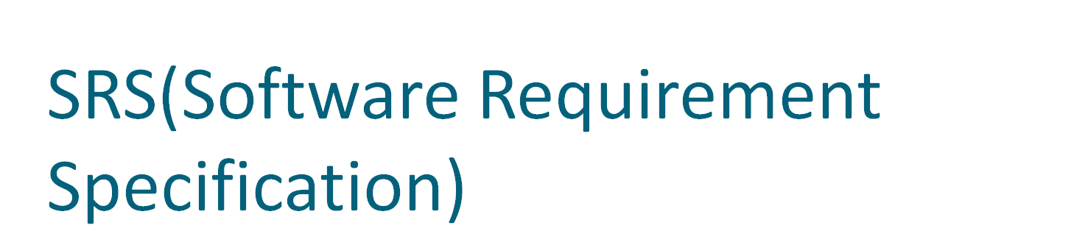

Slide 3
Definition:-
SRS is a document that completely describes what the proposed software should do without describing how the software will do it.
SRS translates the ideas in the mind of the client into a formal document. Thus the output of the phase is the set of formally specified requirement which is called SRS.

Slide 4
Need for SRS:-
The basic need of SRS is to bridge the communication gap between the client and the developer.
It is the medium through which the client and the users need are accurately specified.
Basically, it is the basis of software development. A good SRS should satisfy all the parties such as client, developer and the end user.

Slide 5
Advantage:-
Important purpose of developing SRS is helping the clients understand their own needs.
2) An SRS establishes the basis for agreement between the client and the supplier on what the software product will do.
3) A SRS provides a reference for validation of the final product.
4) A high quality SRS is prerequisite for high quality software.
5) A high quality SRS reduces the development cost.

Slide 6
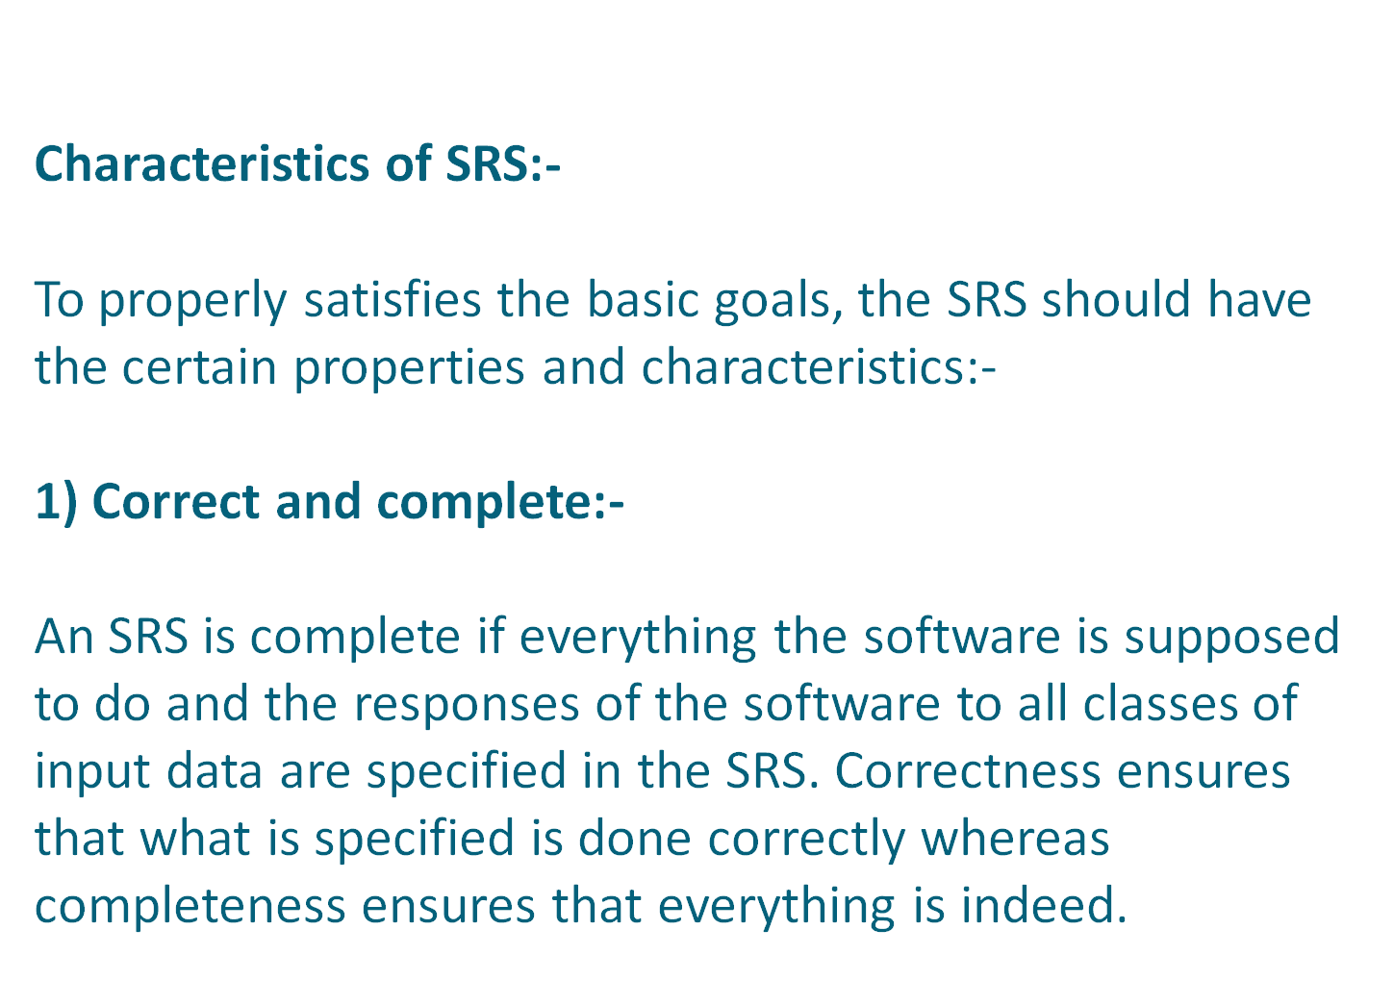

Slide 7
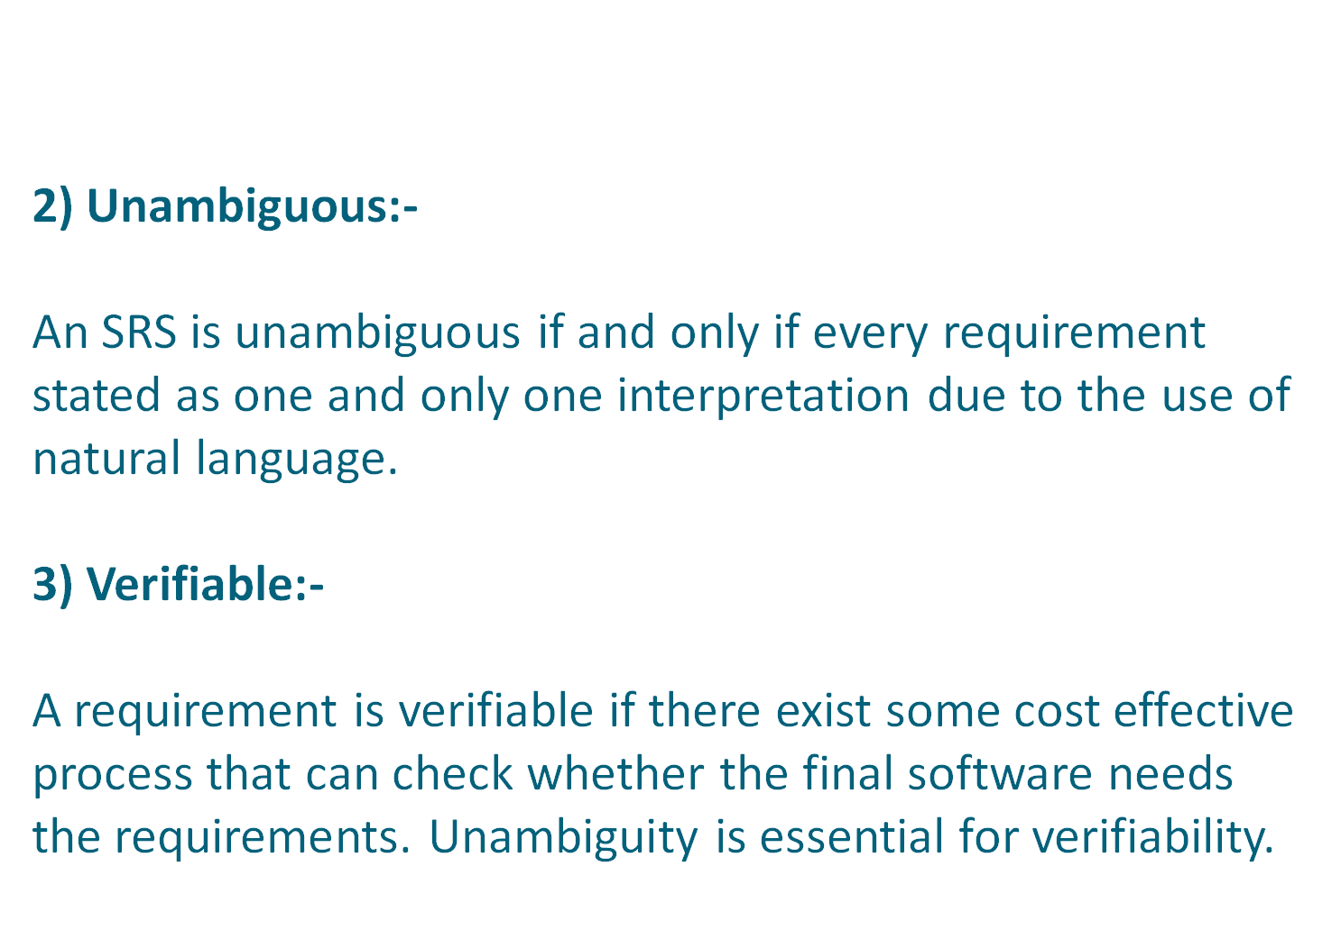

Slide 8
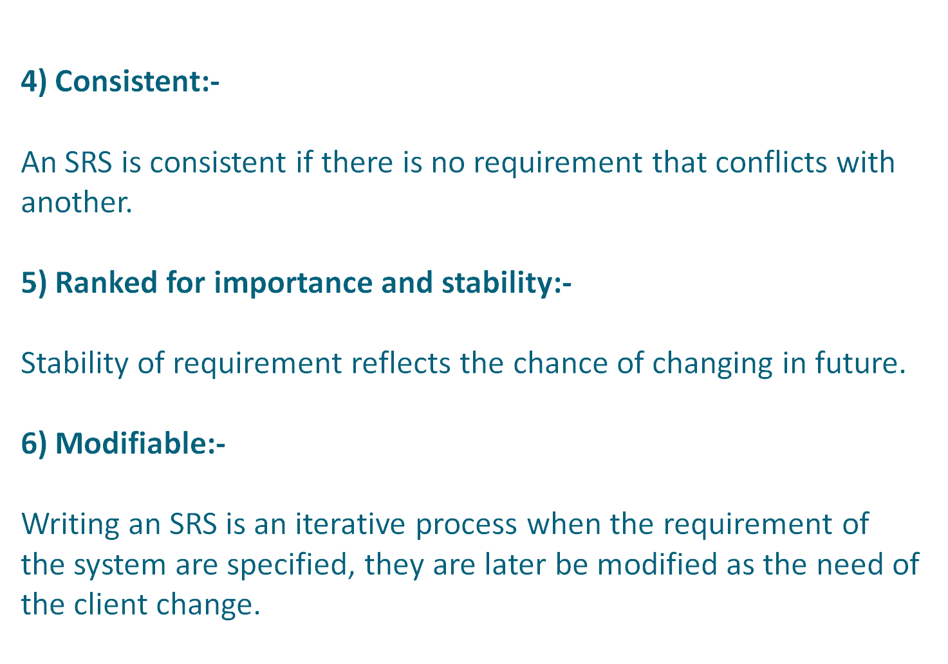

Slide 9
